Slide 1
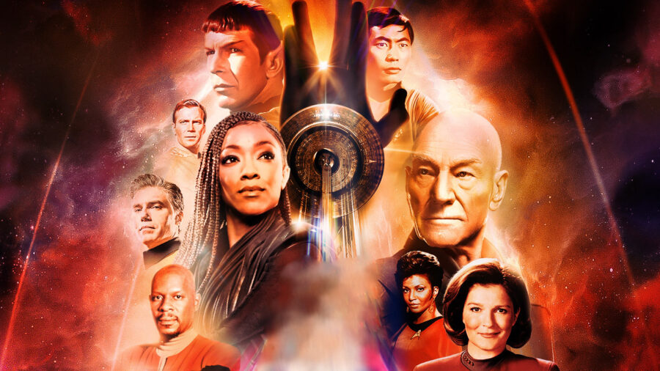

Magic Cat Ranch Productions
Presents
The Star Trek MySQL Training Database

Slide 2
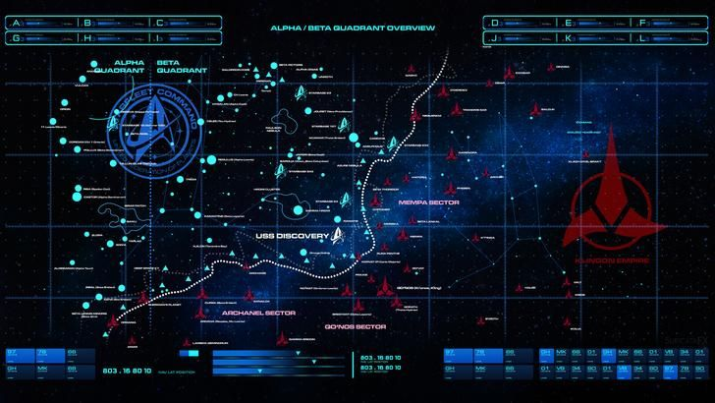


Why Does This Database Exist?
In an attempt to make learning MySQL database technology more interesting I developed a hobby database which utilized information from the Star Trek Franchise

Slide 3

What Did I Create?
By using StarPeople I can add Star-Gate or Star-Wars data in the future
The Tables in the StarPeople Database
characters
Opportunities for performing join operations
compliment
Ships
sfmembers
litinum
stplanets
Notice the naming consistency of the table names
lifeforms
stlanguage
stactors

Slide 4
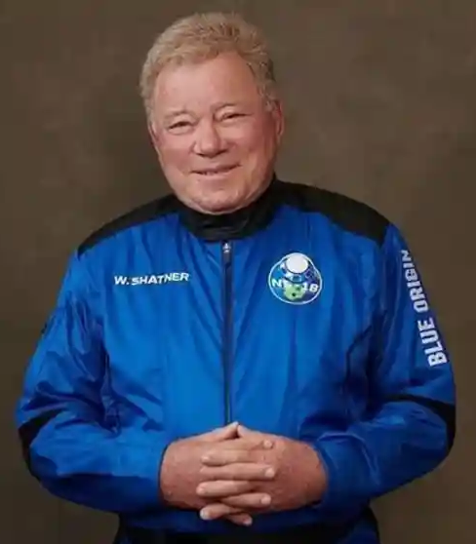
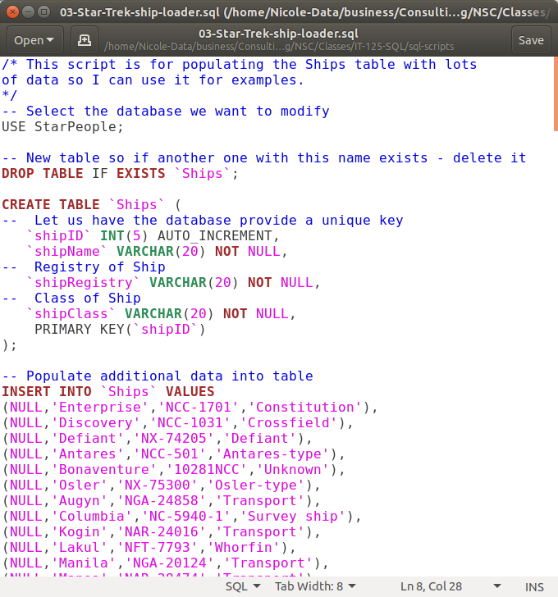
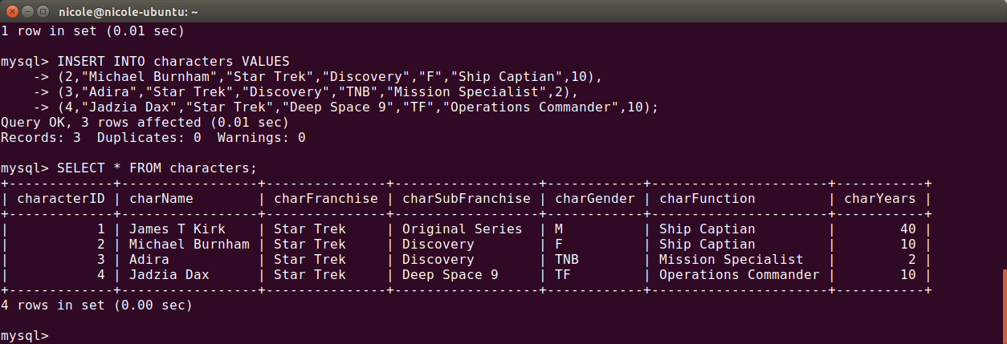
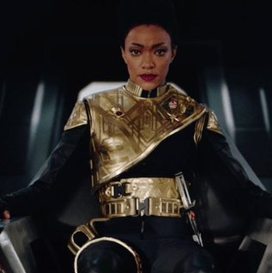
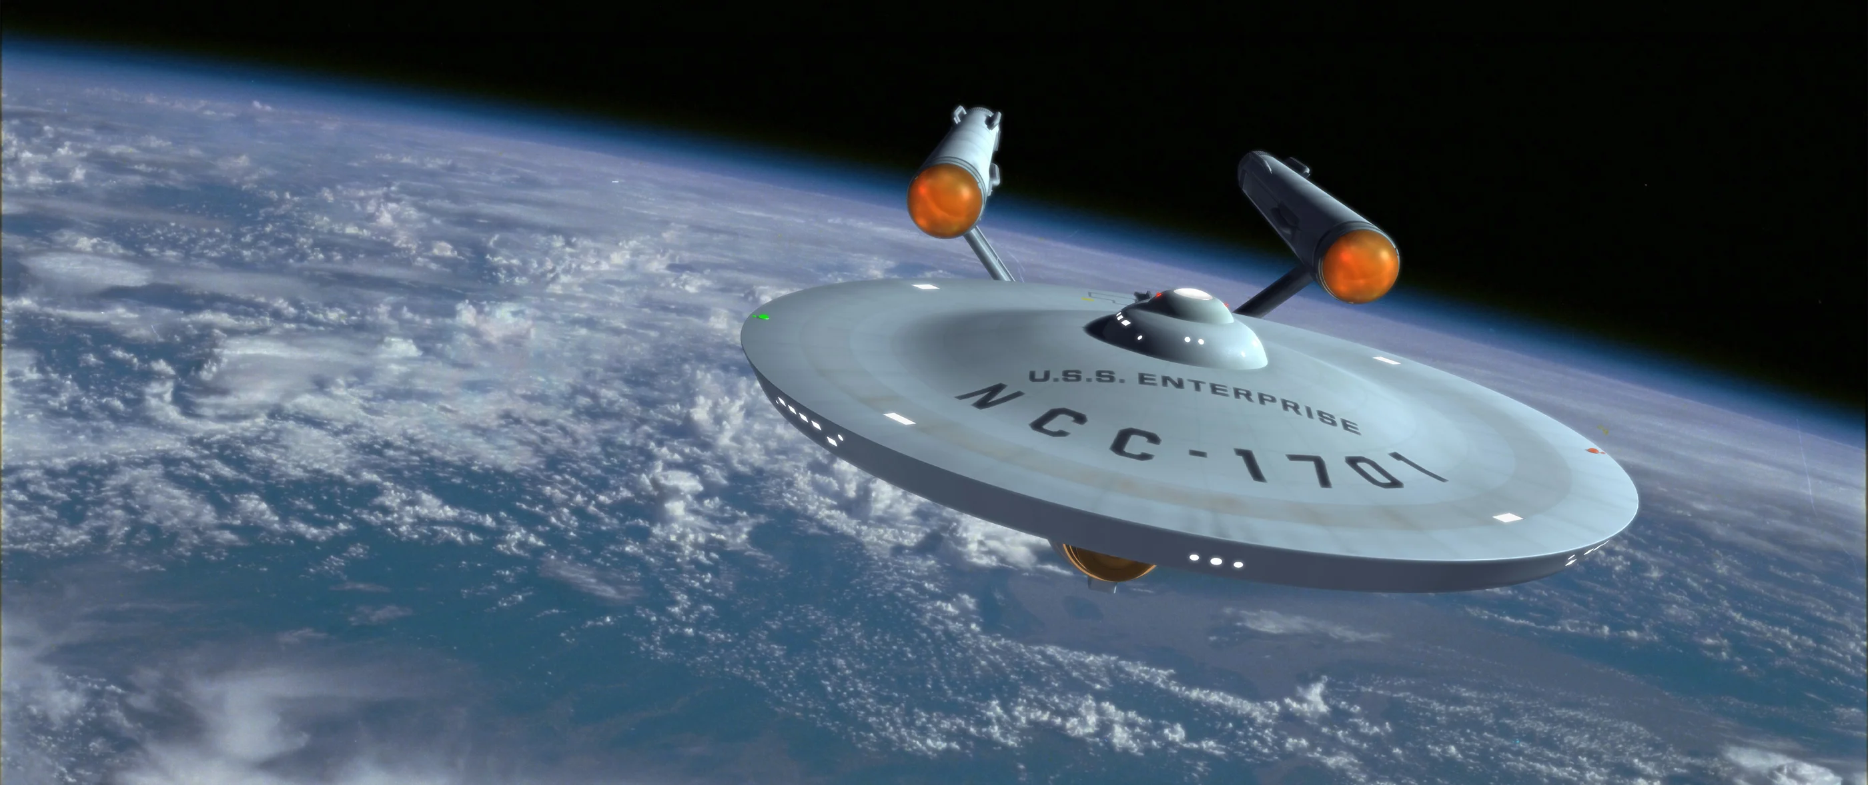
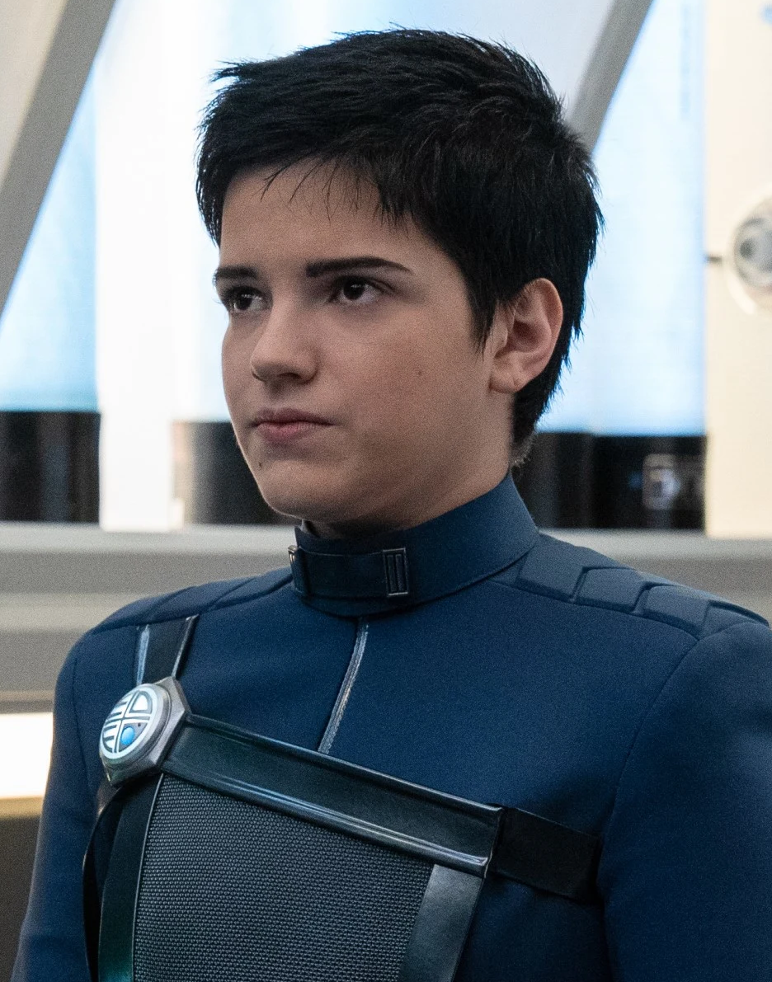
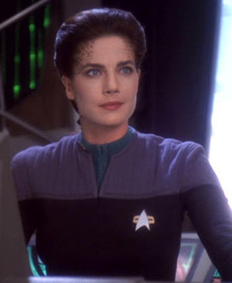
What do the tables Look like
An example of the Ships table from MySQL Workbench
Data grabbed and loaded from online source using batch entry technique
An example of the characters table from MySQL Command Line

Slide 5
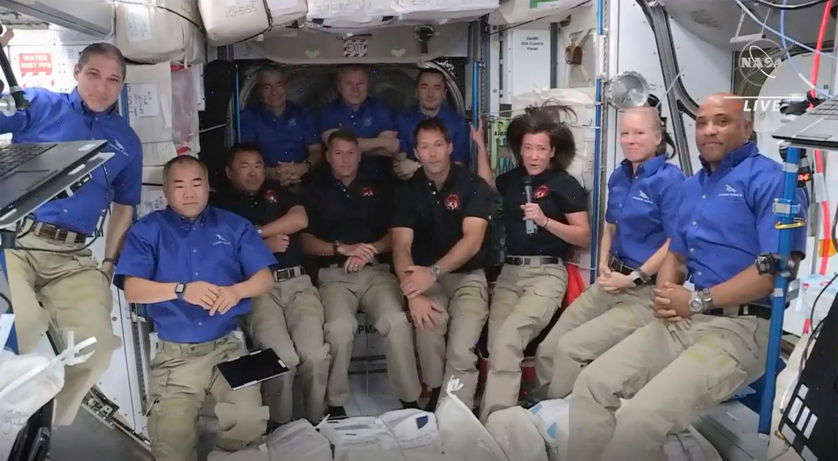
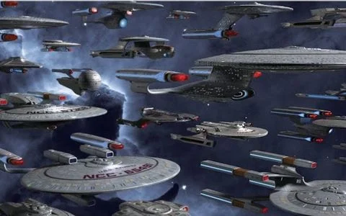
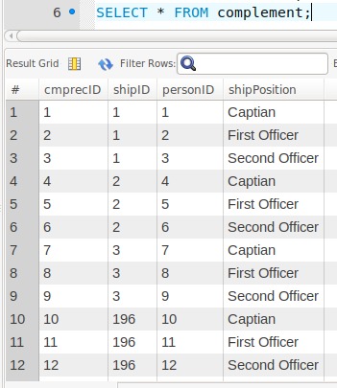
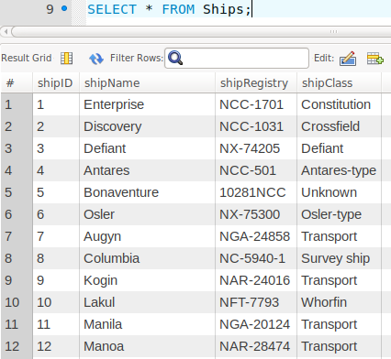
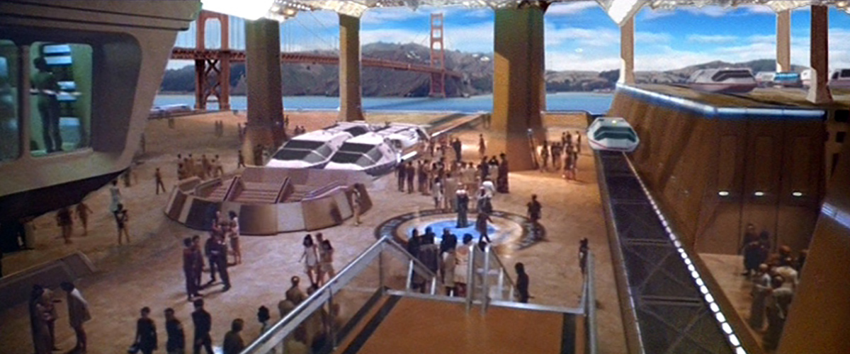
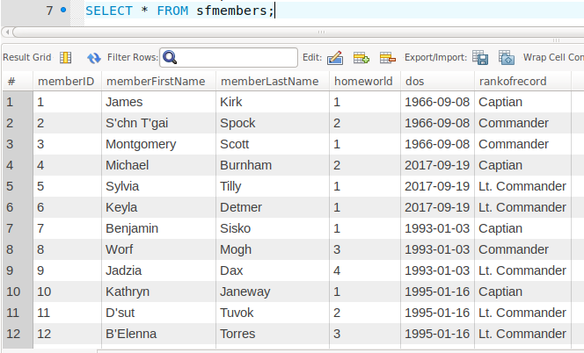
Designed with joins in mind
Members of Star Fleet operate the ships
Ships need a crew
Star Fleet needs ships to explore space

Slide 6
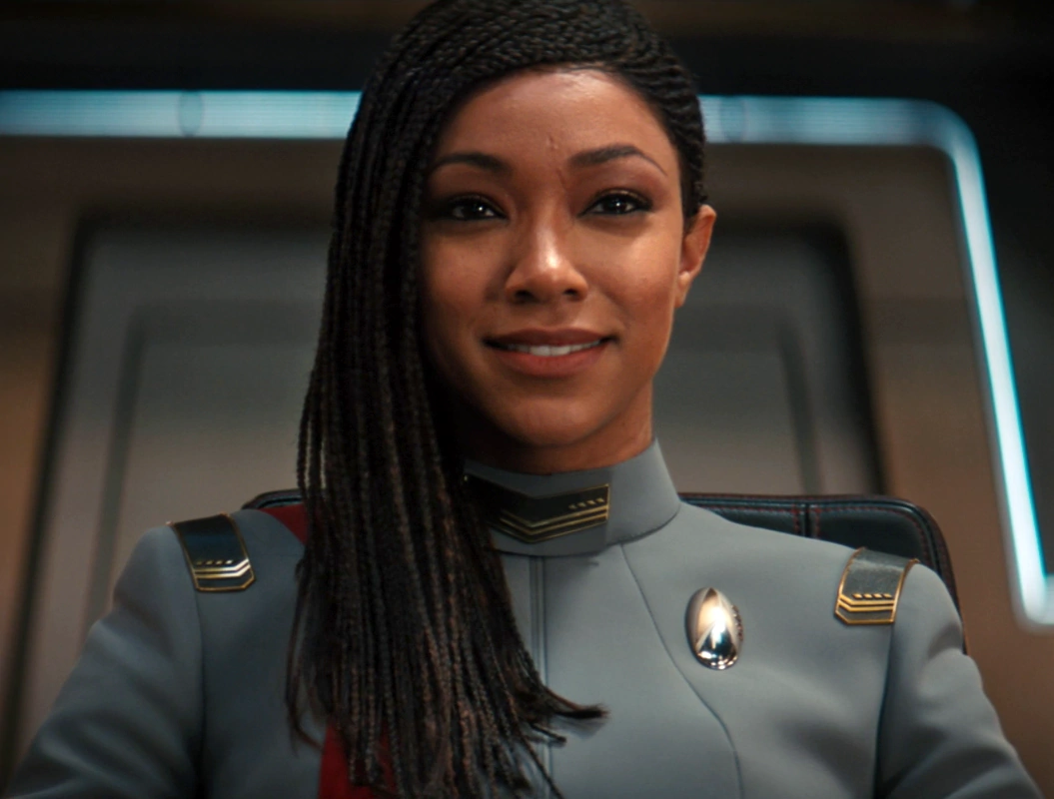
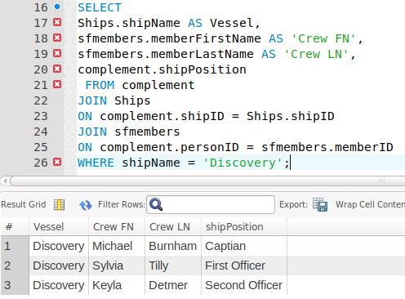

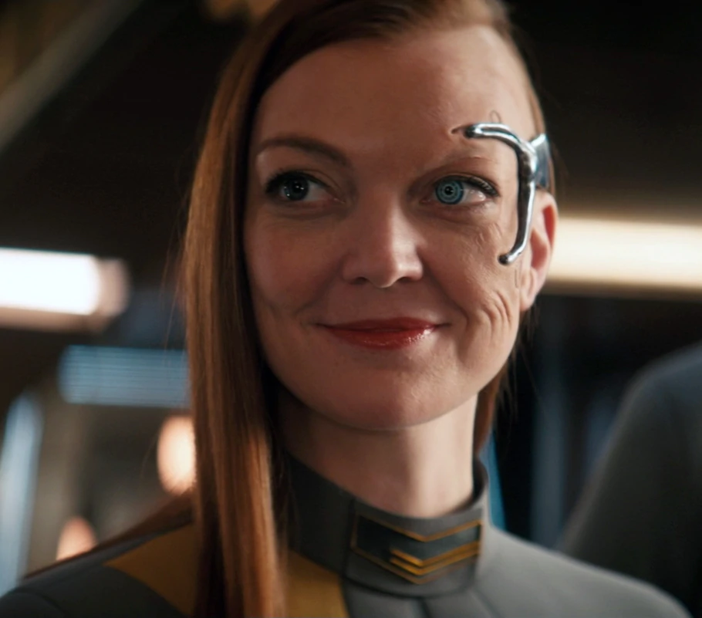
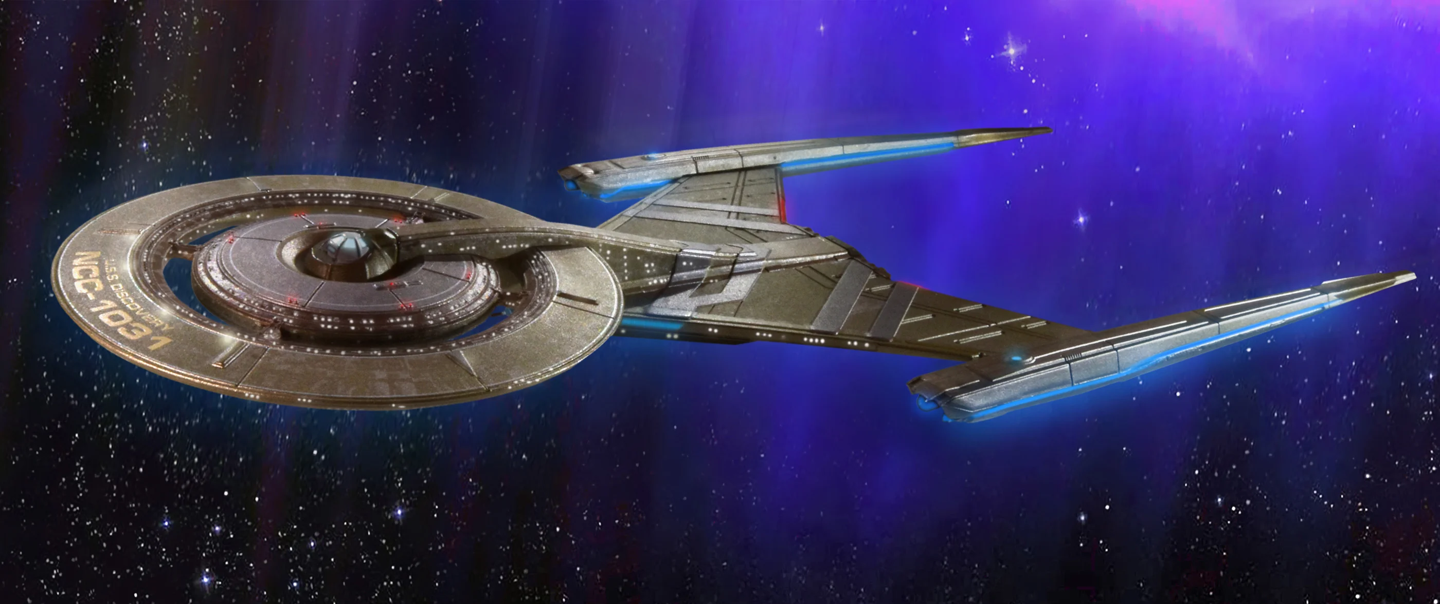
Queries that find just what you want to see

Slide 7
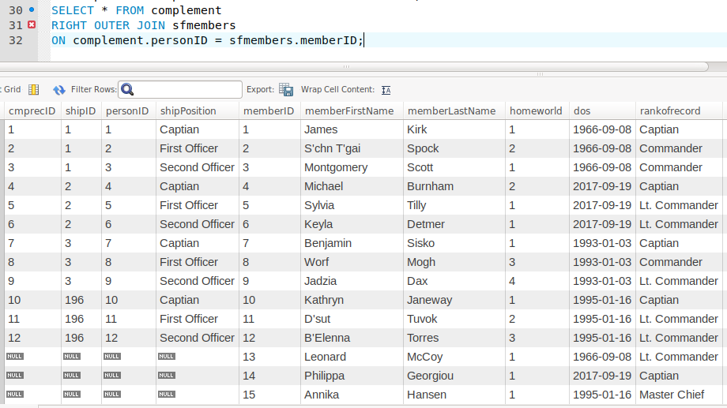
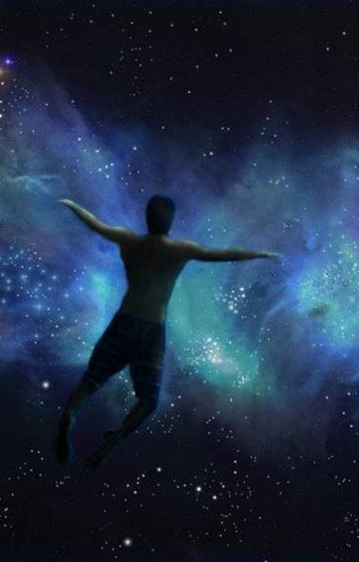
Knowledge of why to Use a Query
Notice that using this Right Outer Join I can now see that I have Crew with no Ship

Slide 8
An Understanding of the importance of Comments
/* Create and load a table that contains the life forms from the
Star Trek Franchise. The Data should be able to uniquely
identify each life-form listed
*/
-- Select the database we want to modify
USE StarPeople;
-- New table so if another one with this name exists - delete it
DROP TABLE IF EXISTS `lifeform`;
CREATE TABLE `lifeform` (
-- Let us have the database provide a unique key
`lifeformID` INT(5) AUTO_INCREMENT,
`lifeformName` VARCHAR(50) NOT NULL,
-- Where are they from
`homeworld` VARCHAR(50) NOT NULL,
-- Does it have another common name
`hwaltname` VARCHAR(50),
-- What environment is required for them to exist
`environment` VARCHAR(50) NOT NULL,
PRIMARY KEY(`lifeformID`)
);
-- Populate initial data into table
INSERT INTO `lifeform` VALUES
(NULL, 'Human', 'Earth', 'Terra', 'Oxygen-Nitrogen'),
(NULL, 'Vulcan', 'Vulcan','Ni\'Var', 'Oxygen-Nitrogen'),
(NULL, 'Klingon', 'Kronos', '(Q\'onoS)', 'Oxygen-Nitrogen');

Slide 9
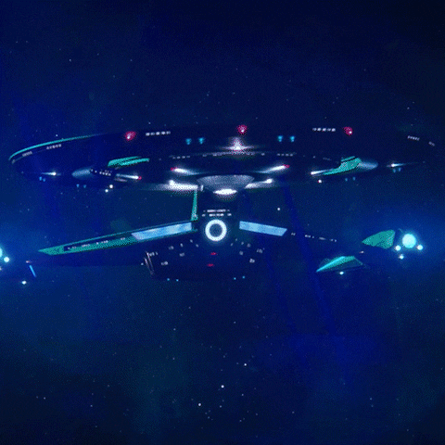
We are done here, Time to go

